Slide 1
MNAO Introduction to Project Management
June 13, 2018

Slide 2
Why are we providing this course?
We are rolling out basic project management across MNAO along with a Project Office to both track projects and assist our project managers
This course provides an introduction to Project Management that can be used to help manage many activities within the business
It includes an introduction to standard templates to be used for reporting project status at MNAO
Guidance on additional education in Project Management will be provided
We will end with information regarding certification (PMI and Mazda certification)

Slide 3

Your instructor for this session
Patrick Halfpenny, Senior Manager, Application Development
Over 23 years of IT and Project Management Experience with Minacs, DaimlerChrysler and MNAO
Served as Minacs first IT project manager
IT Project+ and PMP Certified
University of New Mexico, B.A. Economics
Central Michigan University; Master of Science in Information Resource Management
Portfolio of work includes management of consumer websites for multiple OEMs as well as backend marketing systems

Slide 4

Your instructor for this session
Rob Valle, VP, Information Technology at Mazda
IBM Certified Executive Project Manager
30 years of IT management experience
Experience in managing numerous projects in IT as well as Business Transformation and Divestitures
Major projects include company manufacturing division divestitures, CRM system development, rollout of new systems and processes
Formation of multiple project offices for multi-hundred million dollar operations

Slide 5

Part 1 – Getting Started

Slide 6
What is Project Management and how does it help us?
It is a methodology which helps to keep track of a set of related activities and the team assigned to it – with a focus on time and effort
Helps us break down large activities into manageable tasks
Gives us a consistent way to report our status
Gives us an early warning as problems arise
Provides us with helpful concepts such as - task assignments, start dates, end dates, sizing, critical path, scope management, risk assessment, issue management, phase exits, sign-offs – all of which help us deliver projects on time and within estimate

Slide 7
When I Receive An Assignment - Where Do I Start?
Start by getting answers to the following questions:
What EXACTLY am I being asked to deliver?
What is the scope of this work effort? (i.e., what audience is served by my deliverable? What business unit is supported? What are the functions or capabilities that I must provide?)
What resources are available to work on this effort? If they are part-time, how much time can they devote to my project?
Are there any special timing constraints? (i.e., must be complete by end of next quarter, etc.)
What funding is available?
What are my assumptions?
How is my project dependent on other organizations or projects?
Who is the executive sponsor for this effort?
Be sure to document what you have learned and what you are committing to deliver – and then VALIDATE with the requestor

Slide 8
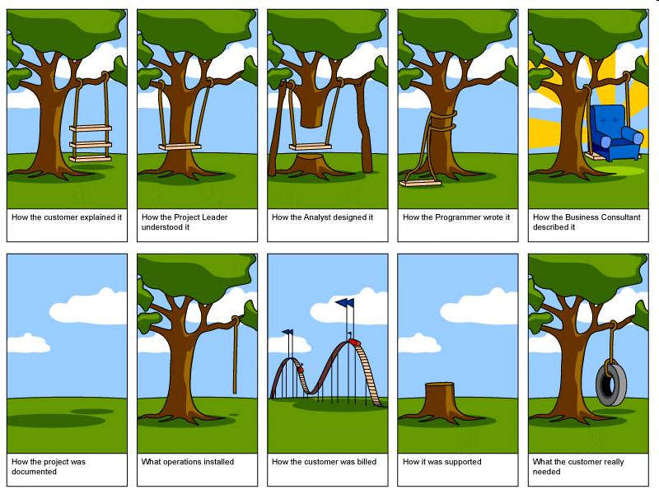
When I Receive An Assignment - Where Do I Start?
Start by getting answers to the following questions:
What EXACTLY am I being asked to deliver?
What is the scope of this work effort? (i.e., what audience is served by my deliverable? What business unit is supported? What are the functions or capabilities that I must provide?)
What resources are available to work on this effort? If they are part-time, how much time can they devote to my project?
Are there any special timing constraints? (i.e., must be complete by end of next quarter, etc.)
What funding is available?
How is my project dependent on other organizations or projects?
Who is the executive sponsor for this effort?
Be sure to document what you have learned and what you are committing to deliver

Slide 9
I have an idea of what I need to do – what are the steps?
Document your deliverables and scope – share this with the sponsor and/or requestor for confirmation
Identify who will be working on this effort
Lay out the large segments of work that have to be completed
Work with your team to break down the segments of work into tasks
Start building your project schedule - which maps out how you get from today to the delivery of your deliverables
Conduct a project kickoff – get everyone on the same page
Schedule regular project status checkpoints
Use the standard topsheet when required to share your status with upper management

Slide 10
Consider hosting a dinner…
Host dinner on Saturday (fixed end date)
Identify guests
Invite guests
Prepare menu
Identify ingredients (# of guests is a prereq)
Check what is available at home
Create shopping list
Purchase missing ingredients
Set Table
Cook the meal (having ingredients is a prereq)
Mix ingredients for main course
Place in oven
Once cooked, move to serving plate
Prepare side dish
Place on stove
Once cooked, move to serving bowl
Prepare dessert
Put in refrigerator

Slide 11
Building a project schedule…
What are your Milestones? (major events which sometimes requires an approval or sign-off before proceeding)
Examples of Milestones are contract approval, requirements document completion, design completion, code completion, test completion, installation completion, etc.)
What are your Tasks?
There are units of work, typically 40 hours or less and assigned to individuals
What’s your critical path?
As you lay out your scheduled tasks on a timeline, with prerequisites defined and being completed before associated tasks can start, it’s the longest duration path in your project (and it can change over the life of the project)
This tells you the earliest you can finish your project

Slide 12
Can you find the Critical Path?
Task 1
(4 hours)
Task 7
(4 hours)
Task 2
(8 hours)
Task 5
(4 hours)
Task 8
(4 hours)
START
END
Task 3
(2 hours)
Task 6
(6 hours)
Task 9
(4 hours)
Task 4
(3 hours)
Task 10
(16 hours)

Slide 13
Critical Path relies on tasks and their prerequisites
Task 1
(4 hours)
Task 7
(4 hours)
Task 2
(8 hours)
Task 5
(4 hours)
Task 8
(4 hours)
START
END
Task 3
(2 hours)
Task 6
(6 hours)
Task 9
(4 hours)
Task 4
(3 hours)
Task 10
(16 hours)
25 hours is the longest path, so if Task 4, 6 or 10 are delayed, the entire project is guaranteed to slip
Tasks 4, 6 and 10 might be: create an education module layout, build the module, deliver the module to the NE region

Slide 14
What’s in a basic project plan?
Task ID | Task Name | Assigned To | Planned Start Date | Actual Start Date | Planned End Date | Actual End Date | PlannedHours | % Comp | Status
1 | Widget Design | Tom | 1/29/2018 | 1/31/ 2018 | 4/01/2018 | Same | 300 | 100% | Production
Simple plans can be tracked via a spreadsheet (for larger, more complex project you can use a tool like Microsoft Project Standard or Professional)

Slide 15
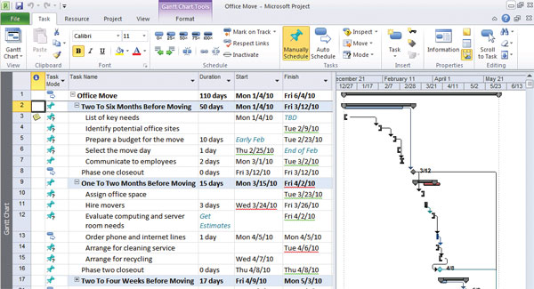
A screenshot from Microsoft Project Standard

Slide 16
The project management triangle
QUALITY
TIME
SCOPE
RESOURCES ($/HC)

Slide 17
Steve Jobs On Teamwork
Key messages – divide work, trust, collaborate…
As a good PM – create an environment that facilities good communication across the project team. You will raise issues that the team will together help address.
YouTube Video

Slide 18

Part 2 – Additional ingredients

Slide 19
Getting everyone aligned with a Project Charter
This is a document that is prepared at the start of a project (typically a larger, complex project with multiple parties)
The scope of the project is documented
It lays out roles and responsibilities across the parties
It clearly highlights ownership and overall accountability
It includes risks and assumptions
It may include formal sign-offs
A project charter will help flush out misunderstandings before the project starts in earnest
The IT PMO has a template available for those interested

Slide 20
How to handle “scope creep”
The initial project plan supports the initial scope and objectives
Over the course of the project, requirements may change, new deliverables may be required, or deliverables already underway may need to be altered
A common mistake is to accept these changes without assessing the impact to the project schedule, budget or resources
Assess the requested change, identify changes needed to the project plan, and determine the new end date or move to backlog
Gain agreement from all stakeholders not only to apply the change, but to the modified plan
Document the change of scope, the impact to the project plan, and the agreement to the new plan

Slide 21
Dealing with change
Scope creep is just one aspect of change in a project
Other changes that can be encountered:
Initial estimates were too low
Key resources are lost during the project, and new resources require onboarding time
Resource demands from outside the project pull cycles away
Unexpected technology impacts that impact the team’s productivity
The important lesson is to MANAGE the change – that means taking stock of the impact, and adjusting the project plan accordingly
Changes to the plan must be documented and reported – do not try to manage impacts within the project – maintain transparency

Slide 22
Reporting your status using a top sheet
Simple one page view of the status of your project
Color coding provides an immediate snapshot of project health (red, yellow, green)
Shows what work is complete and what is underway
Highlights which activities are at risk of missing their targets
Highlights the issues and what is being done to address them
A format like this can been used on small or large-scale projects

Slide 23

Use a top sheet to share your status
Reporting Date: xx/xx/xx
EVP Review: Yes/No
<PROJECT TITLE>
Infra Req: _ Committed: _
Data Req: _ Committed: _
App Req: _ Committed: _
Project Milestones and Key Activities/Deliverables | Planned Start | Revised Start | Planned End | Revised End | Status R/Y/G
Initiation <define each row per project>
Discovery (example)
Requirements (example)
Design New Process (example)
Process Review (example)
Develop New Guidelines (example)
Develop Communications (example)
Create Rollout Plan (example)
Conduct Training (example)
Begin New Operations (example)
Overall Project Status: On budget:
Project Leader: xxxxx
MNAO Manager : xxxxxxx
Business Executive: xxxxx
Vendor Lead: xxxxxxx
Last Week
This Week
Project Description
<brief description of the project, including any special business challenges or objectives, platform, etc.>
Critical Activities (This Week)
<brief description of critical issue encountered this week, as well as major accomplishments.>
Key Open Issues | Plan to Address
<open issue> | <plan to address issue>

Slide 24
The left section provides an overall view of the project
For small, simple projects, the top sheet may capture much of the project plan
For larger projects, show the milestones on the top sheet
The milestone may be a phase exit, or when an important deliverable is complete
This offers overall status, sequence of activities, ownership, slips, areas of concern, etc. in one view.
The open critical issues section calls attention to major factors that must be addressed, and sometimes require executive support
Use the color coding to highlight areas that are slipping or are being impacted by issues
The audience always focuses on the RED!

Slide 25
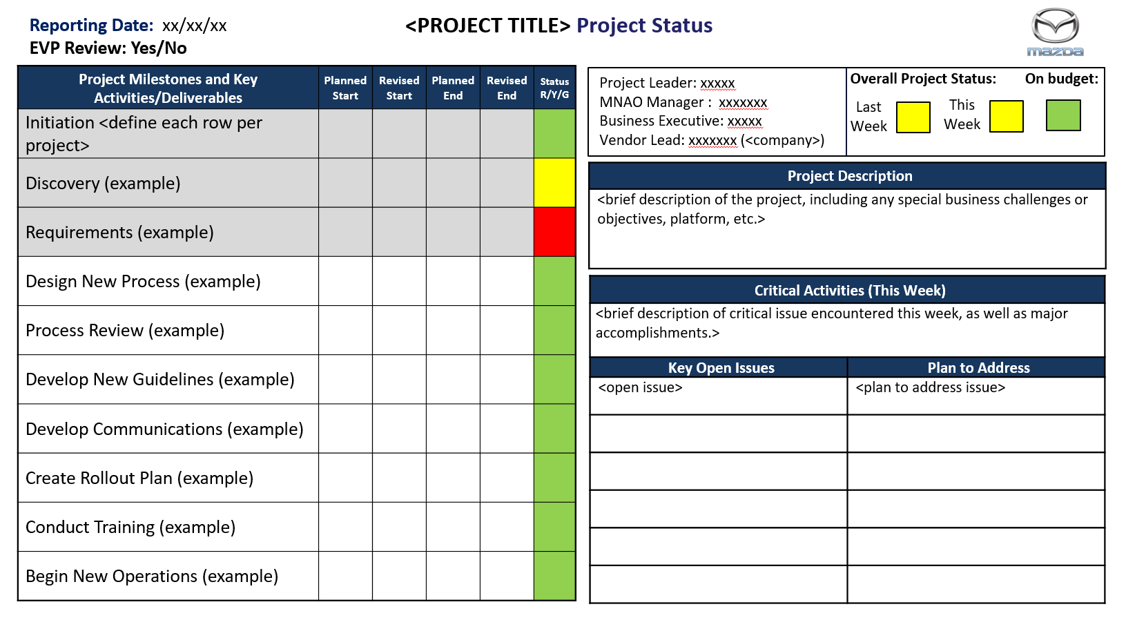
A closer look at the top sheet…
Specify if this rolls up to EVP
First time – complete title, Project Lead and owners, and lay out all project milestones and key activities
Update report date
Shade completed rows in gray
Confirm cross dependency
Overall status this week and last; also overall budget status
Infra Req: _ Committed: _
Data Req: _ Committed: _
App Req: _ Committed: _
Create a relevant view of milestones for THIS project
What happened this week?
Update status of key milestones and activities, only modify revised dates. Update row color status.
Remove closed issues, add new issues and plans, update open issues

Slide 26
Issue Management
Issues impact your project and are typically external factors (not planned for) - they may be due to technology, audience, other organizations, etc. If not addressed, they will delay or even prevent your delivery
Each issue should be identified, assigned to someone for resolution, have a plan to address it and tracked to closure
Your top sheet will show the major open issues, but as a project manager you should maintain a complete list with status
Again, a spreadsheet is useful, capturing: issue title, description, assigned to, date identified, planned date to be closed, action to close and status (open or closed and an indicator of severity)

Slide 27
Issue Log
Issue | Owner | Date Opened | Target Date | Priority (L, M, H) | Actions to Close | Status (Open, Closed)
When Issues are not resolved, they will cause impact the project
Use the log to track your issues – make sure they have owners; focus on progress by tracking the target date for closure
Be proactive. Ensure the issue is understood, has an owner, and a plan and date for closure.
If you have no owner or date for a high priority issue, your project is in RED status

Slide 28
Dealing with risks
For some projects, you will want to identify risks and associated mitigation plans. Better to plan for a disaster before it happens, then be caught without a plan
Risks are determined by playing out “what if” scenarios…
What will happen if I cannot fully staff key roles?
What will happen if a critical dependency fails to deliver?
For each risk, create a mitigation plan
Some mitigation plans may require an additional investment
However, if the risk is serious enough, it is warranted to reduce overall project risk
Often, a mitigation plan may be a manual process, or a method for falling back to original processes
You may also have risks that may occur over the course of the project (technical environment unavailable for UAT, etc.)

Slide 29
Formal steps in risk management
Risk Identification – they may identified at any time in the project life cycle, but the earlier the better
Risk Analysis – this includes understanding the impact of the risk (very high to very low) and the probability it will occur (again, very high to very low). This allows the risks to be prioritized
Response Planning – how will you respond to the risk? Develop executable plans to respond to the risk if it becomes reality
Tracking and Control – Monitor the risks. Risks can change over the life of a project, and as they change, response plans will change
Reaction – Implement risk actions when the actual risk occurs

Slide 30
Contingency management
No project plan is perfect – there will always be deviations – sometimes for the better but more typically for the worse
Consider the overall complexity of the project and any uncertainties
Establish a contingency factor
The contingency is applied to the project budget as a percentage
A contingency factor may also be applied to the end date (often as additional test or development time)
Setting contingencies at the start helps manage expectations

Slide 31
Agile versus Waterfall
Waterfall refers to phased projects which start at basic requirements and end with a completed deliverable
Common phases like requirements, design, build, test and rollout
Agile is a different way to structure a project and team
Iterative “sprints”
Daily stand-ups (scrum meetings)
Direct user involvement on teams
Agile is not new nor is it necessarily faster (a common assumption given the name) – but can provide small drops of function sooner
The Agile Manifesto was written in 2001

Slide 32

Project management – the completion date

Slide 33


Part 3 – Conclusion

Slide 34
Start with the basics
Create a simple project plan for efforts that have clear deliverables, a target date and multiple resources
For very large efforts, consider the project charter
Use the top sheet to report overall status
Identify and track issues
Address scope changes with appropriate re-planning
Ask the IT PMO for guidance

Slide 35
Some reasons why projects fail
Failure to set and manage customer expectations/scope
Failure to manage scope/requirement changes (“scope creep”)
Poor requirements (incomplete, not fully understood, inaccurate)
Inaccurate estimates (effort to complete tasks)
Lack of contingency planning/funding
Poor project management
Project plan not sufficiently detailed/decomposed
Project organization/roles not clearly defined
Lack of change control
Failure to plan for project risks (this is related to contingency management)
Inadequate communications and project reporting
Poor senior management support
Typically a lack of support for scope change management
Problems with new products/technologies
Skill shortfall on project team
At a broader initiative level, failure to deliver committed business benefits (stemming from inaccurate/overly optimistic business justification)

Slide 36
Growing in the project management discipline
Reading is highly recommended first step. Some reasonable books are…
The Phoenix Project
Project Management for Dummies
Making Things Happen: Mastering Project Management
Use these techniques in the workplace where they lend themselves
Experience is the best teacher in planning, estimating, reporting, managing issues and risks, etc.
Project Management professionals will earn PMI (PM Institute) PMP (PM Professional) certification, but multiple certification exist such as Program Management, Business Analysis and Scheduling
See the www.pmi.org website ($139 annual membership for access to materials)

Slide 37

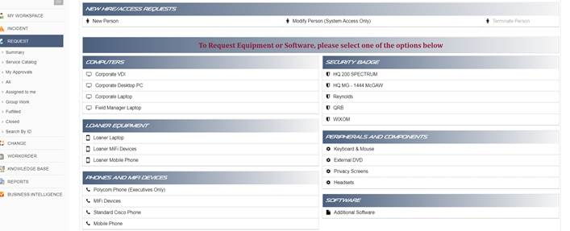
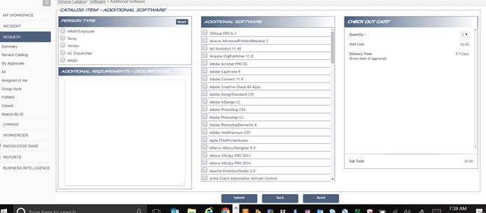
Instructions for downloading Microsoft Project
Go to mits.mazdausa.com
1. Login
2. Go to Requests/Service Catalog
3. Click Additional Software/select Microsoft Project and then Submit!

